Slide 1
Azure API Management
Speaker Name

Slide 2
What’s in common?
Internet
of
Things
Machine
Learning
Mobile
APIs
Software
as a
Service
Cloud
Computing
Blockchain

Slide 3
The Rise of APIs
Technology landscape is more distributed than ever
On-prem, cloud, SaaS, edge, mobile
APIs started on the periphery and moved to the core of enterprise IT
As technology for building APIs got better and expertise became available more broadly
Now the default way of exposing services and data
HTTP, JSON, OpenAPI, OAuth
Key business driver – API economy
Customer loyalty, satisfaction, growth ecosystems, agility
Well-suited for ad-hoc integration
Due to standards, common patterns, and tools
API-aware workflow/orchestration products accelerate time to value
Rapid, no/low-code solution development
Subject to network effects
Every additional API increases the value of the rest

Slide 4
“Application programming interfaces (APIs) make digital society and digital business work. They connect people, businesses and things. They enable new digital products and business models for services, and create new business channels. APIs make digital business work.”
From the Gartner research note “Top 10 Things CIOs Need to Know About APIs and the API Economy”
By Paolo Malinverno, Kristin R. Moyer, Mark O'Neill, Mike Gilpin
Published 25 January 2017

Slide 5
Leading
Digital transformation
Applications are everywhere
Data is everywhere
Connect everything
API based integration is the backbone

Slide 6


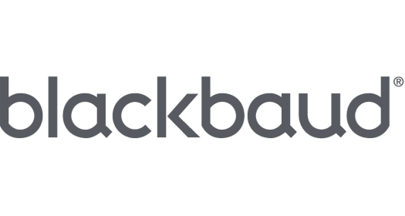


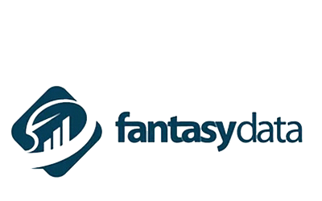



Customer use cases
Enterprise API catalog
Customer and partner integration
Mobile enablement and IoT
APIs as a business
Gateway for microservices
http://aka.ms/apimcustomers

Slide 7
 | Customers | Instances | Calls | APIs
Growth (trailing 12 months) | +50% | +65% | +530% | +244%
Total (as of end of May 2018) | 10.5K | 17.4K | 77B | 112K
Notes:
12

Slide 8
“Application programming interfaces open new business opportunities. However, too many CIOs make the mistake of seeing APIs as technology only, instead of basing their company's business models, digital strategies and ecosystems on them.”
From the Gartner research note “Top 10 Things CIOs Need to Know About APIs and the API Economy”
By Paolo Malinverno, Kristin R. Moyer, Mark O'Neill, Mike Gilpin
Published 25 January 2017

Slide 9



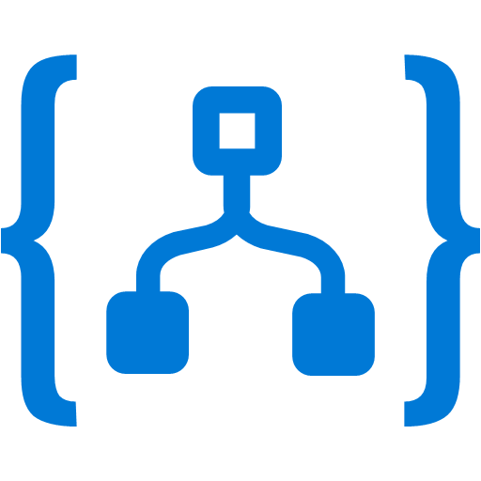
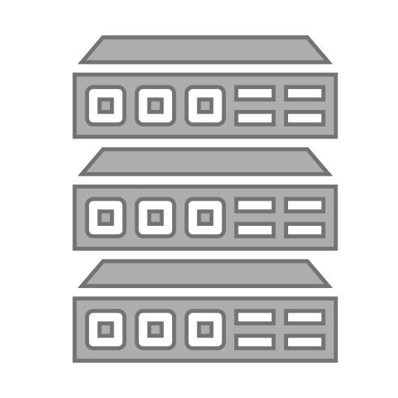


API Management
Discover
Learn
Get access
Try
Get help
SDKs and samples
1st and 3rd party apps
Abstract
Secure & protect
Manage lifecycle
Monitor & measure
Onboard developers
Monetize
Consume
Mediate
Publish
Developer portal
Gateway
Azure portal
App developers
API publishers
APIs hosted on and outside of Azure

Slide 10





Façade and front door
Developer portal
Consume
App developers
Gateway
Mediate
1st and 3rd party apps
contosoapi-foo.azurewebsites.com
Azure portal
Publish
APIs on Azure and outside
API managers and developers

Slide 11
Façade and front door
Gateway
Mediate
contoso.azure-api.net/foo
contosoapi-foo.azurewebsites.com
1st and 3rd party apps
api.contoso.com/foo
contosoapi-bar.azurewebsites.com

Slide 12
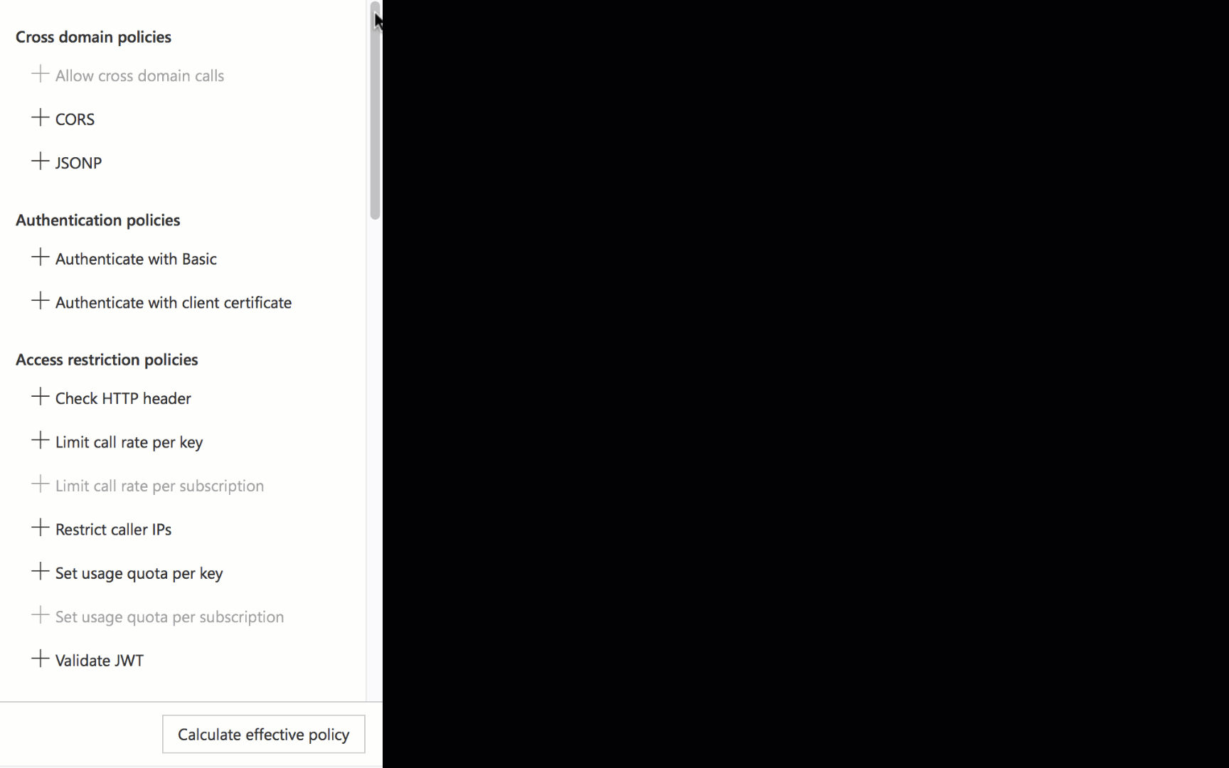
There is a policy for that
Encapsulate common API management functions
Access control, Protection, Transformation, Caching, …
Mutate request context or change API behavior
Add a header or throttle for example
Set in the inbound and outbound directions
Applied at a variety of scopes or on error
Scope determines which APIs are affected
Can define custom scopes in addition to four available b default
Composed into a pipeline from effective scopes
Degree of control over inheritance of scopes, i.e. <base/> element
Don’t delete <base/> inadvertently
http://aka.ms/apimpolicyexamples

Slide 13
Policy scopes
GET /foo/bar HTTP/1.1
Host: api.constoso.com
Key: 0123456789
global
CORS
LOG
0123456789
product
from caller
RATE
QUOTA
inbound
to backend
/foo
api
JWT
/bar
operation
CACHE
URL
BODY
to caller
from backend
outbound

Slide 14
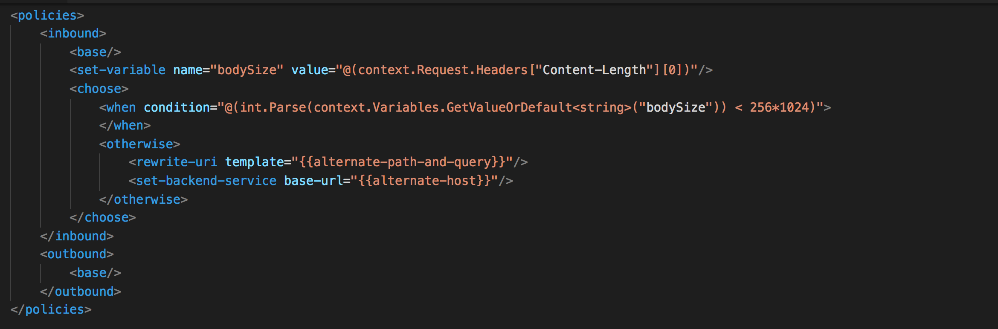
Policy expressions
Named values
C# “snippets” used with policies
Read-only access to the request context
Can use whitelisted .NET types
Dynamically configure and conditionally execute policies
Shared across APIM instance
Keep secrets and “magic” strings out of policies
Add semantics, if named well
Enable a single point of change
Provide environment-specific values

Slide 15
Our approach to versioning
No one true way
Version or not?
Semantic versioning?
What is a breaking change?
Where to place version information?
Path? Query? Header? Media type?
How to identify version?
Number? Date? Name?
Approach
Versioning is an opt-in
Natively understand versions at the system level
Offer versioning scheme options
Inform developers about the changes
Control when the changes get adopted
Revisions
Providers choose when to deploy
Versions
Consumers choose when to adopt

Slide 16
Revisions without versions
Service Instance
API
Operation
Revision
;rev=1
/speakers
/sessions
/days
https://example.org/
foo
;rev=2
;rev=3
;rev=4

Slide 17
Versions and revisions
Service Instance
API
Version
Revision
Operation
/v1
;rev=1
;rev=2
;rev=3
/speakers
/sessions
/days
https://example.org/
foo
;rev=4
/v2
;rev=1
/events
/speakers
/sessions
/venues
;rev=2

Slide 18

Security and protection
Username/Password
Internet IPs
Microsoft account
Google account
Facebook account
Twitter account
Delegated (custom)
Azure AD
Azure AD B2C
Developer portal
App developers
Consume
Key
OAuth 2 & OpenID Connect
Client certificate
Custom external authorizer
IP filter
Rate limits and quotas
Gateway
HTTP Basic
Mutual certificate
Shared secret
IP filter
VNET/NSG
Mediate
1st and 3rd party apps
Azure portal
Azure account
RBAC
APIs on Azure and outside
Publish
API publishers

Slide 19
VNETs and Hybrid
Developer portal
Consume
App developers
VNET
Gateway
Mediate
1st and 3rd party apps
Azure portal
Publish
APIs on Azure and outside
API managers and developers

Slide 20



VNETs and Hybrid
VPN
VNET
Gateway
Mediate
1st and 3rd party apps

Slide 21
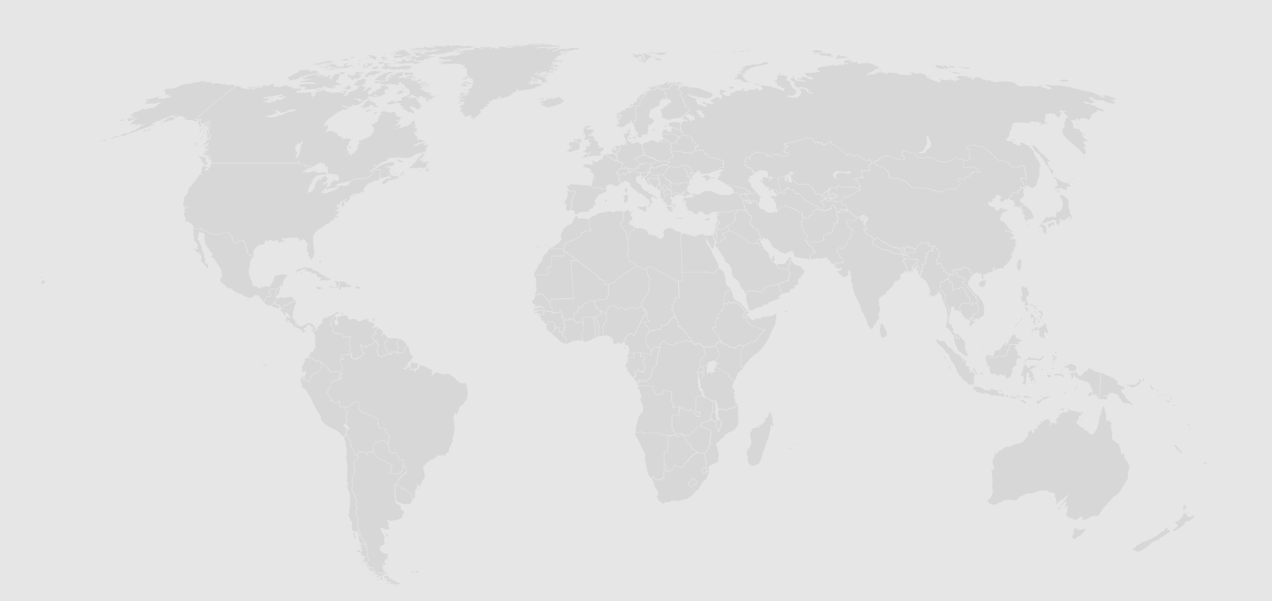
Regional availability
30 public regions in Americas, Europe, Asia and Australia
6 US Government regions and 2 regions in China

Slide 22
Multi-region topologies

Slide 23

Multi-region topologies
Secondary
region
Primary
region

Slide 24
Multi-region topologies
Secondary
region
Primary
region

Slide 25
Multi-region topologies
Secondary
region
Primary
region
Shared state
Hint: use <choose> to <set-backend> policy based on context.Deployment.Region

Slide 26
Multi-region topologies
Secondary
region
Primary
region
Shared state

Slide 27
Multi-region topologies
Secondary
region
Primary
region
Shared state

Slide 28

Multi-region topologies – custom TM
Secondary
regions
Primary
region
Secondary
region
Shared state
Shared state

Slide 29
We just scratched the surface
40 policies - security, transformations, traffic management, extensibility
SOAP and SOAP to REST
API publishing with products, users and groups
Capacity metric and auto scale
Azure Monitor metrics, logs and alerts
Analytics and Power BI template
Debugging and real-time analytics with Application Insights
Key Vault integration
Developer portal customization
…

Slide 30
Stay in touch
Questions and discussions | http://aka.ms/apimso
Service updates, among other things | http://aka.ms/apimblog
GitHub repo with sample policies | http://aka.ms/apimpolicyexamples
Tutorial, documentation, and references | http://aka.ms/apidocs
Feedback and feature requests | http://aka.ms/apimwish
Roadmap | http://aka.ms/apimroadmap
Customer stories | http://aka.ms/apimcustomers

Slide 31
“Differentiation does not come from building your own API management platform. It comes from the APIs you publish to your ecosystems of developers, and how motivated they are to realize application constructs that turn into a business advantage for you.”
From the Gartner research note “Top 10 Things CIOs Need to Know About APIs and the API Economy”
By Paolo Malinverno, Kristin R. Moyer, Mark O'Neill, Mike Gilpin
Published 25 January 2017

